Slide 1

Wine: History and Analysis
By Team Pygeons:
Angel Alejandro, Kevin Beygi,
Matthew Hawk, Renato Mello

Slide 2

Wine: History and Analysis
By Team Pygeons:
Angel Alejandro, Kevin Beygi,
Matthew Hawk, Renato Mello

Slide 3
Our Data
Global Wine History Data
Source: Anderson, K. and V. Pinilla (with the assistance of A.J. Holmes), Annual Database of Global Wine Markets, 1835 to 2016, freely available in Excel at the University of Adelaide’s Wine Economics Research Centre, November 2017 www.adelaide.edu.au/wine-econ/databases/global-wine-history
Collection of Wine Reviews
Over 130,000 wine reviews done by Wine Enthusiast Magazine, https://www.kaggle.com/zynicide/wine-reviews

Slide 4
Motivation & Summary
Hypotheses:
1) Wine has become more and more popular with time.
2) Wine ratings play a significant role in their price
3) Wine consumption has become more widespread
Summary:
History of wine production and consumption
Wine in the US
Wine Popularity and Ratings
The evolution of wine consumption in the world

Slide 5
Questions
What is the global wine consumption/production in 2016?
What are the trends for the wine industry in the US?
Which wine types are the most popular?
What is the correlation between wine ratings and price?
Which wines are produced by Country/Region?
How has consumption of wine varied in time and geography?

Slide 6
Data Wrangling
Global Wine Database
Extracted required data (10 worksheets)
Renaming of columns and skipping of header rows
Reviews data manipulation
Removed wines with missing country, price or rating
Lumping the wine varieties
From 700 to 9 main categories and 76 Sub-categories (using dictionary)

Slide 7
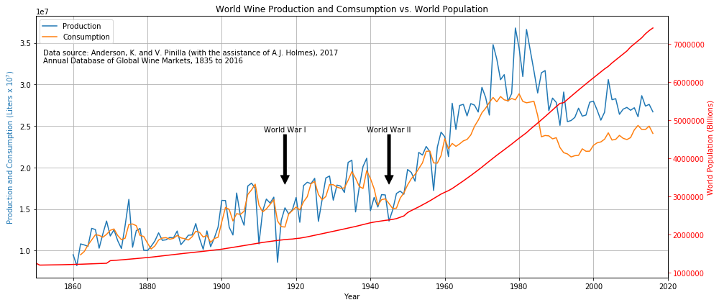
Global Wine Production and Consumption
Notes:
We assumed the wine consumption had increased consistently from World War II
We were surprised and decided to also plot the world population to compare. Used the TWINX call to allow for data with different Y scales to be plotted together.
Some research has been done over the fall in consumption, lead by the top consumers in Europe (Italy, France), mostly blamed on the mixing of cultures, leading to lower acceptable levels of drinking. Apparently beer has replaced a lot of the wine market share of alcoholic beverages as well.

Slide 8
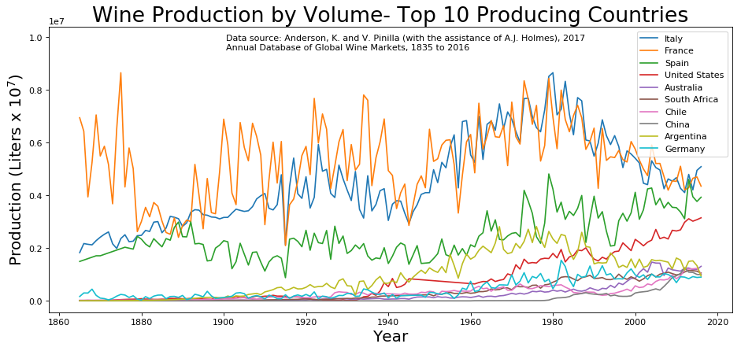
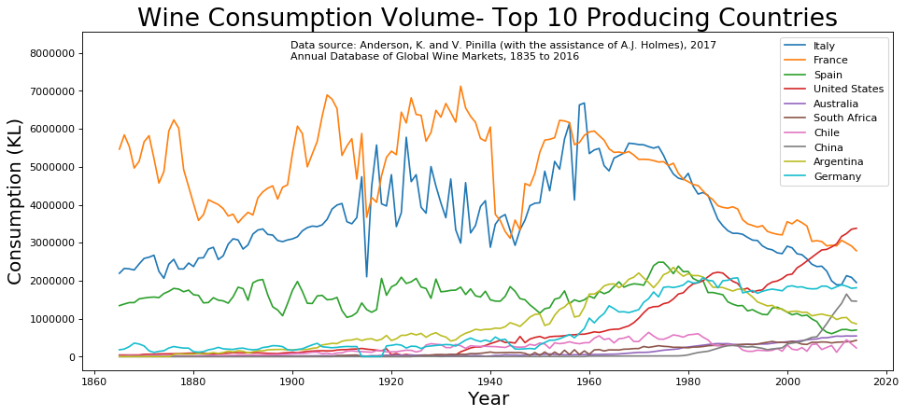
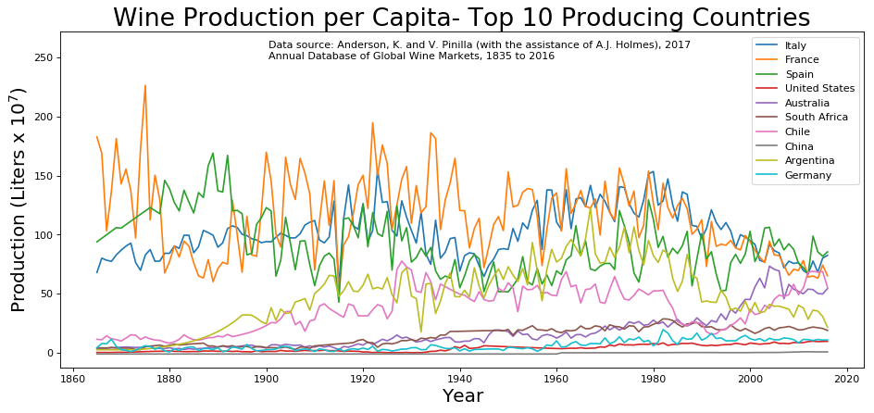
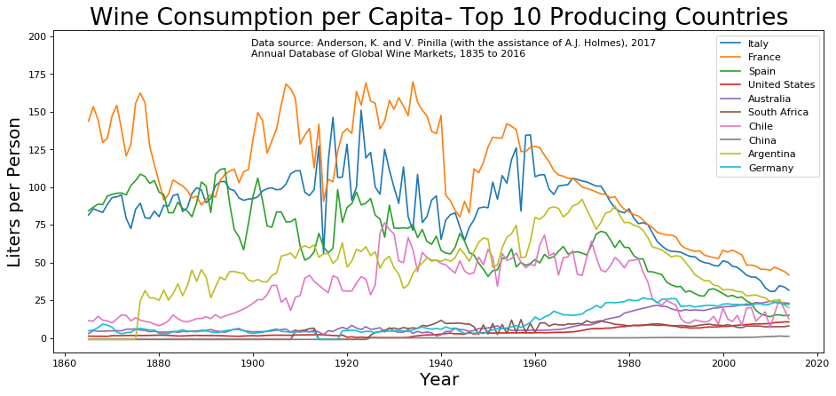
Comparative Analysis of 10 Countries
Global Wine Production
Global Wine Consumption
Total
Per Capita
1850 1900 1950 2000
1850 1900 1950 2000

Slide 9
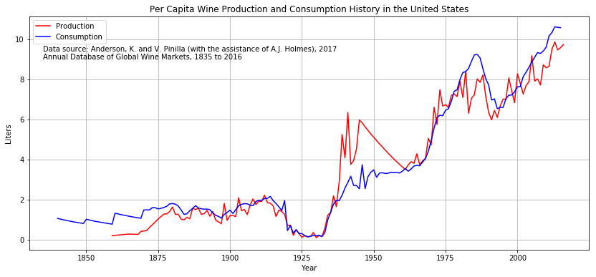
History of Wine Production and Consumption in the United States (1835-2016)
Notes:
We notice 2 periods of sharp drop in consumption and production (~1920-1933 and ~1985-1995). Does anybody know or guess why? (answers in the next slide)

Slide 10
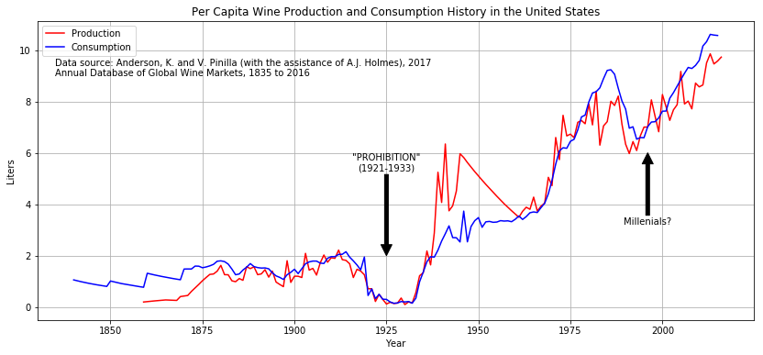
History of Wine Production and Consumption in the United States (1835-2016)
Notes:
The prohibition (1921-1933) can certainly be admitted as the cause of the first trough.
The second one was the subject of several studies, all pointing to multiple factors such as health conscious consumers as well as the aging of older drinkers, but the turn at about 1995 is mostly credited to millennials, who are currently (2017 numbers), 42% of the wine consumers.

Slide 11
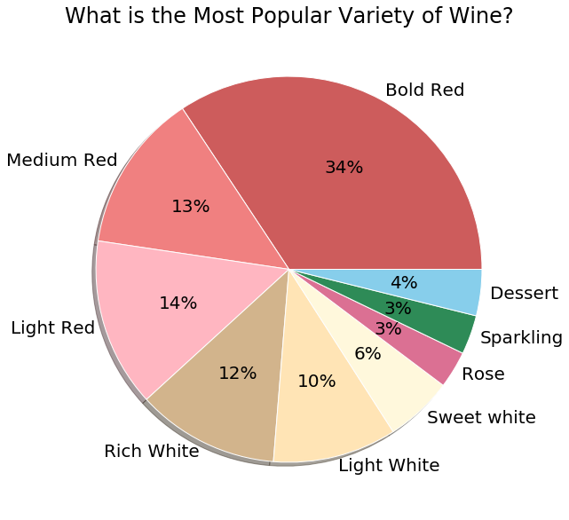

Slide 12
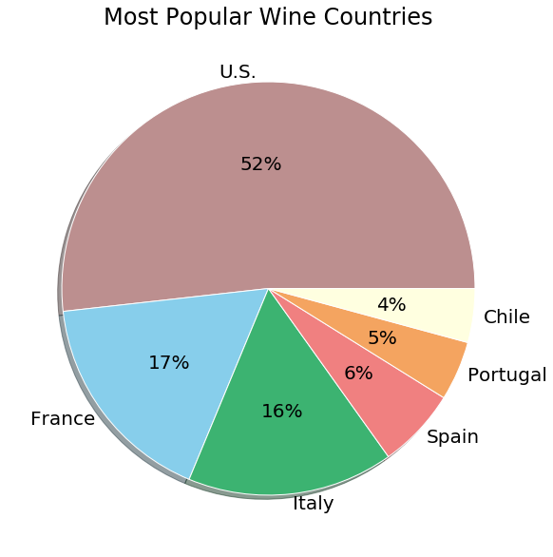
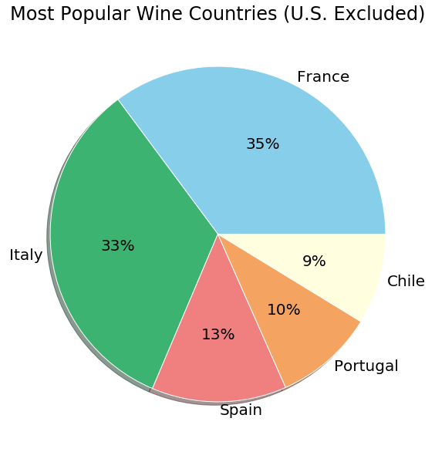

Slide 13
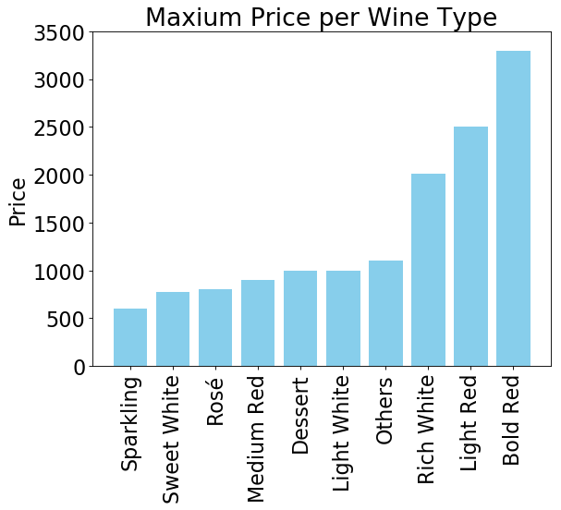
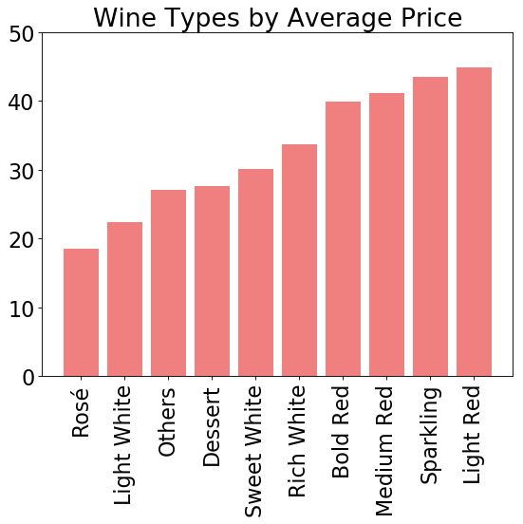

Slide 14
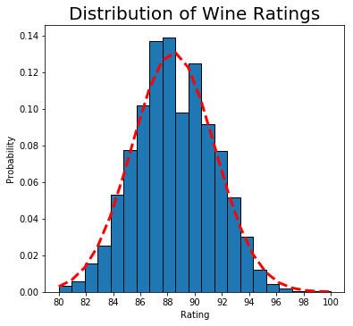
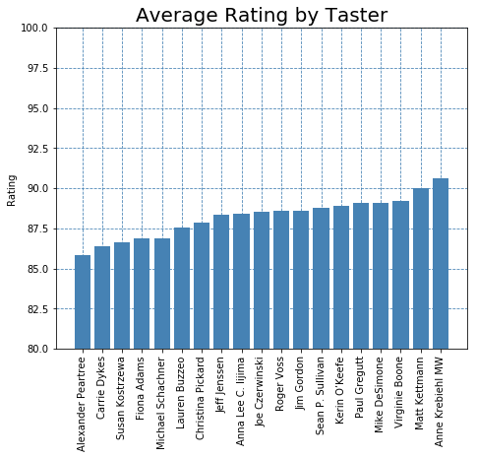
How do average ratings compare among tasters?
Mean = 88.4
Std Dev = 3.04
Notes:
Ratings are distributed normally
We do not see significant difference between testers average reviews

Slide 15
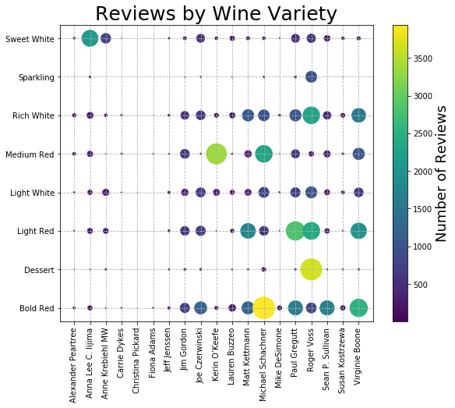
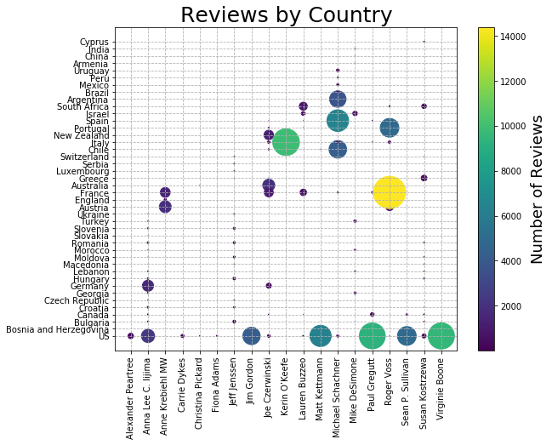

Do tasters show a preference to review wines from certain varieties or countries?
Notes:
Reviewers tends to review several varieties of wine, they don not seem to specialize in a few
Reviewers do show country specialization, for each reviewer the vast majority of the reviews are for 3 countries or less

Slide 16
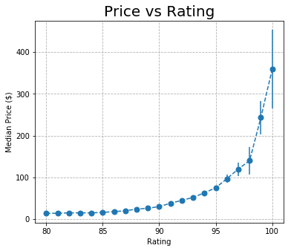
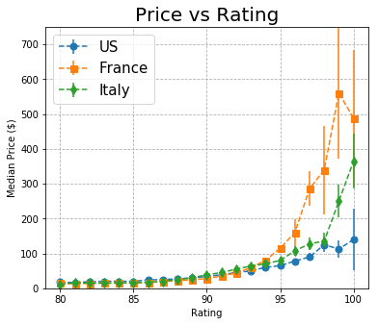
Relation Between Price and Rating

Slide 17
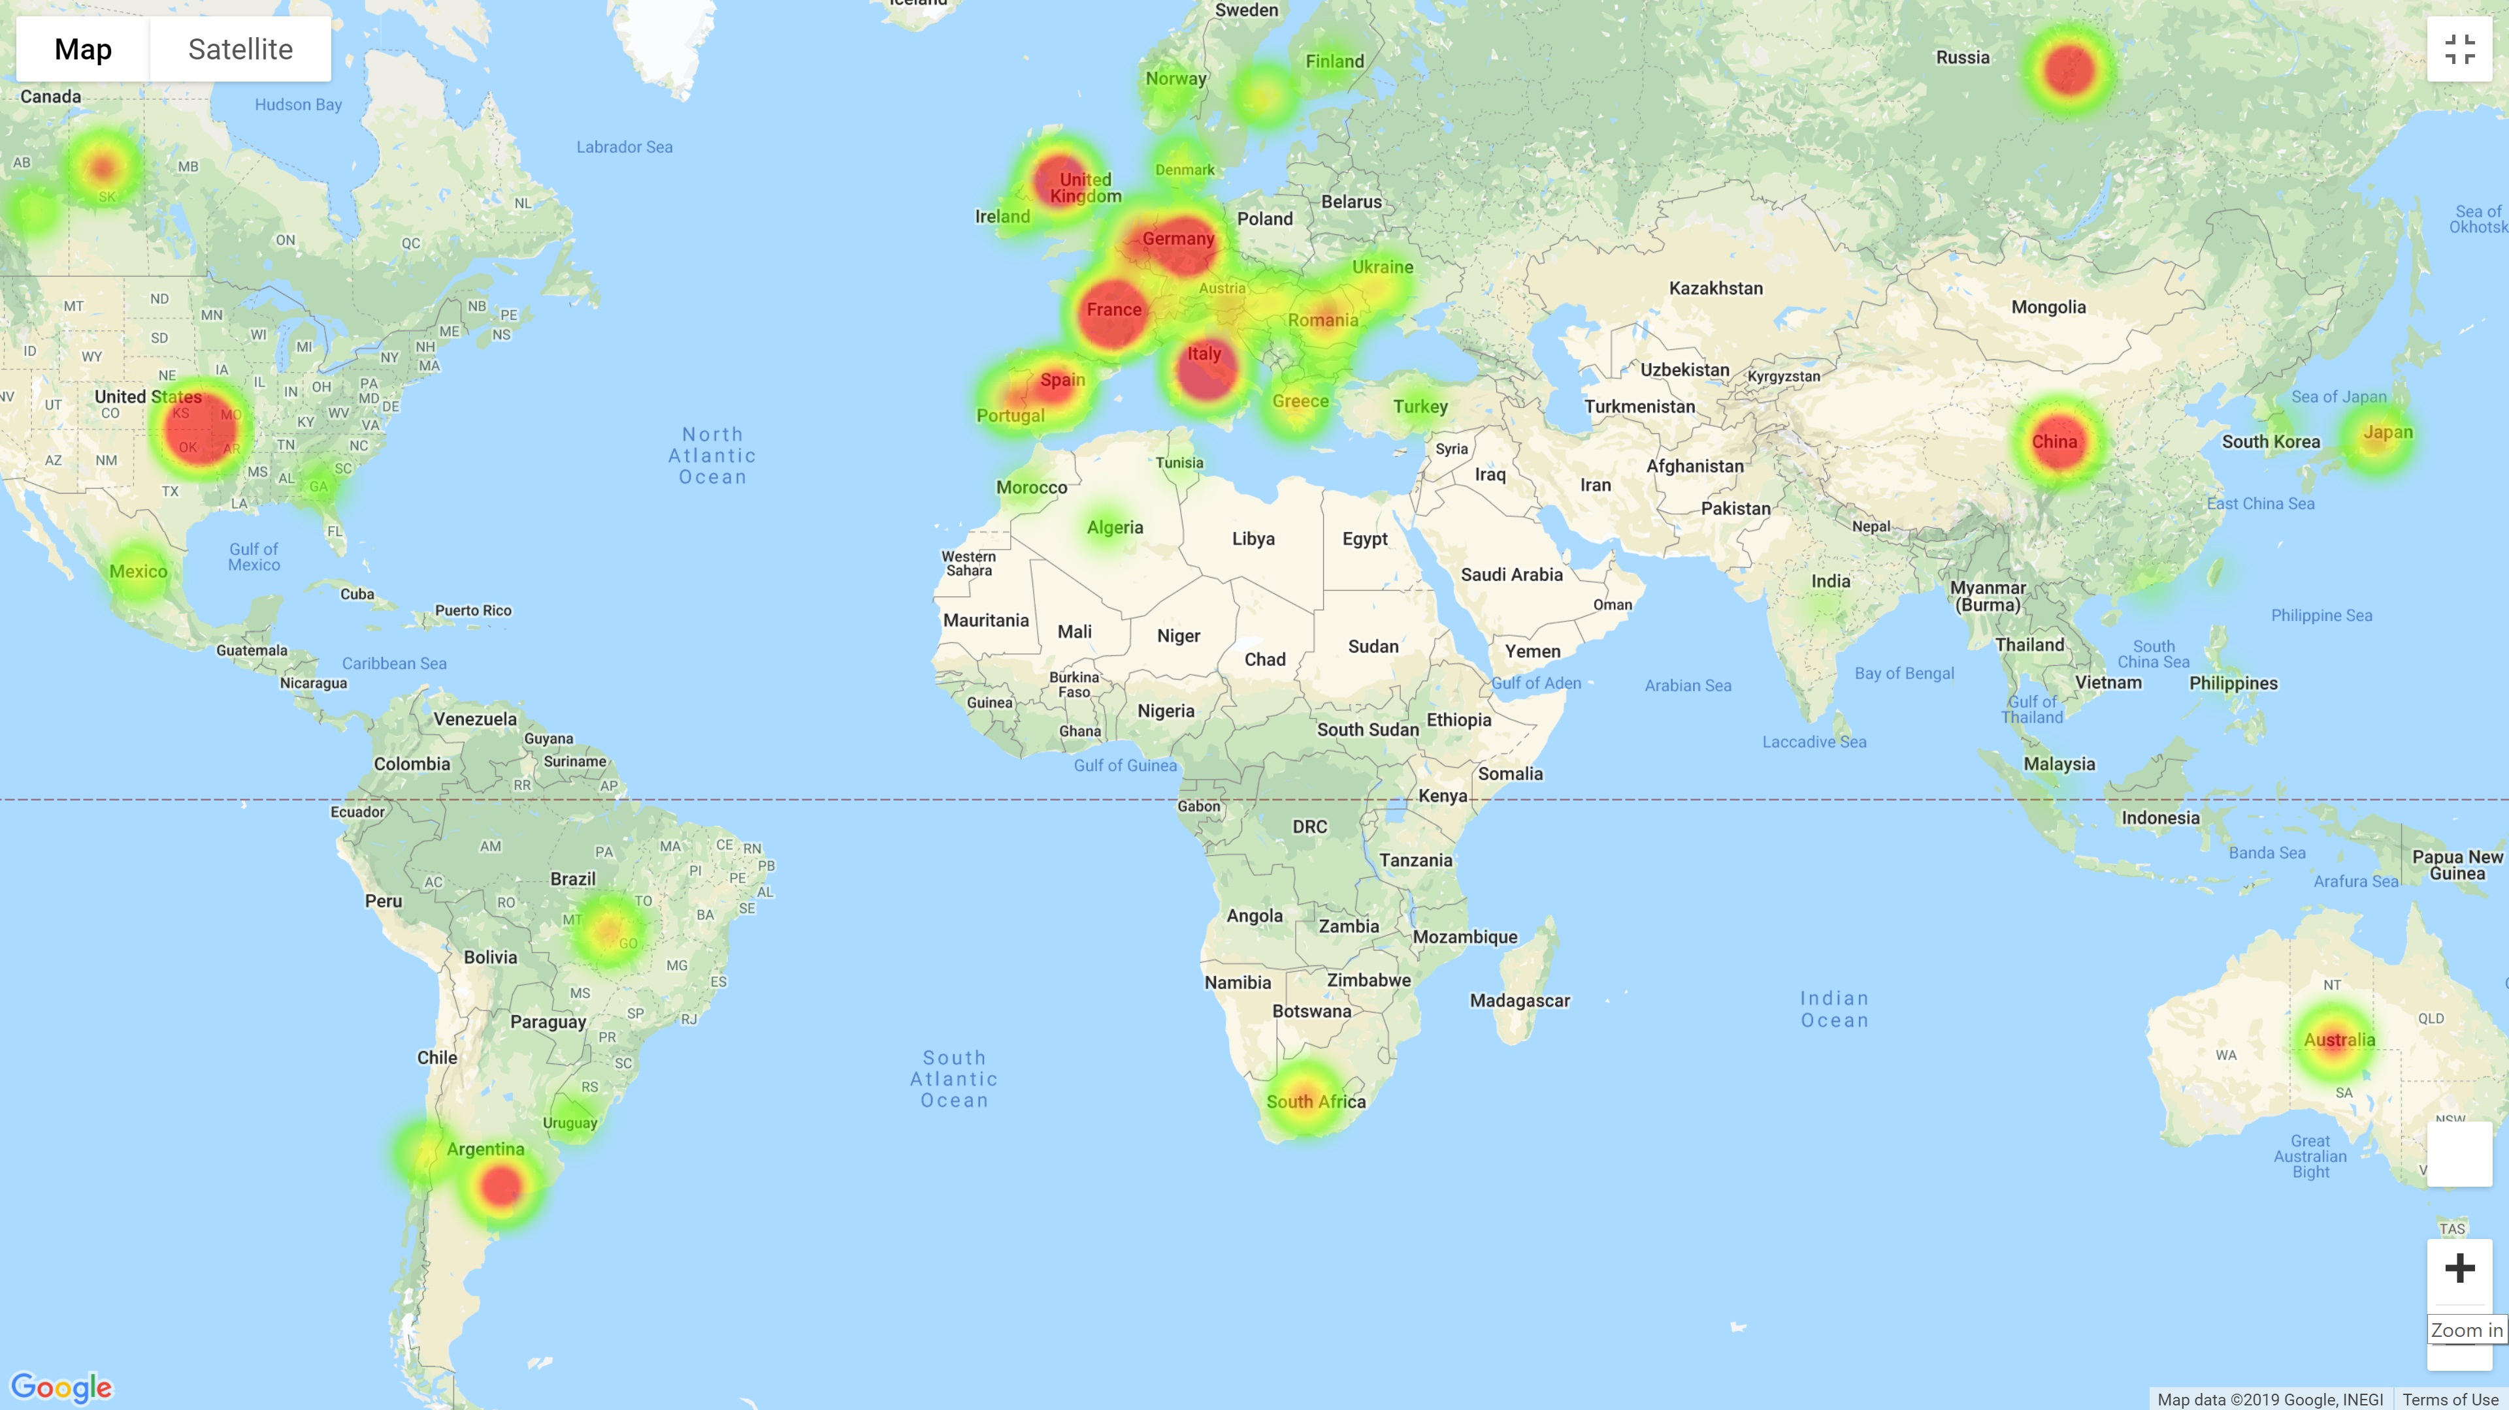
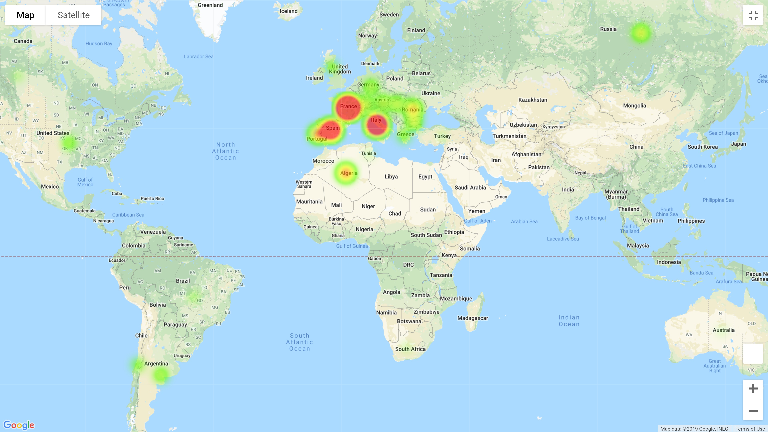
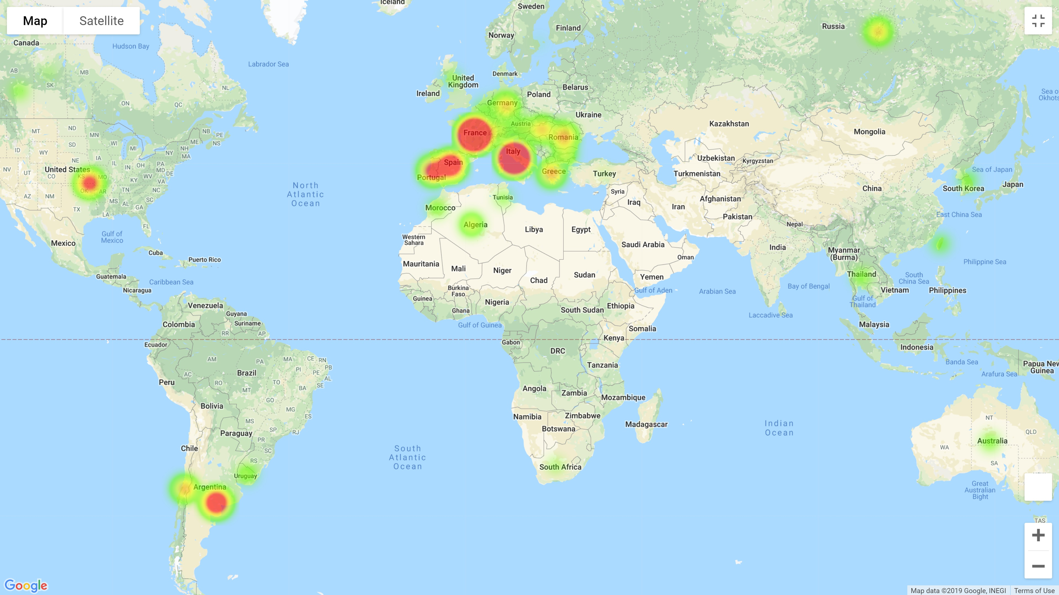
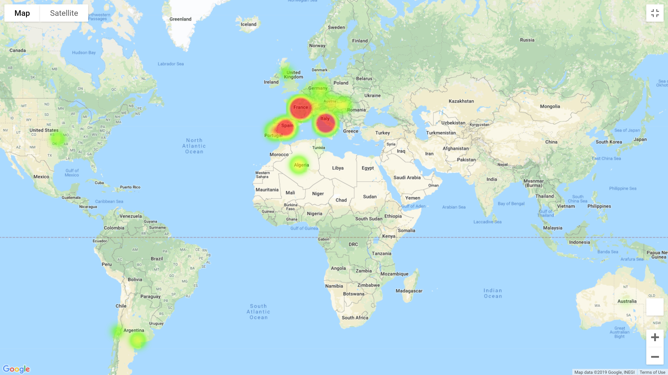
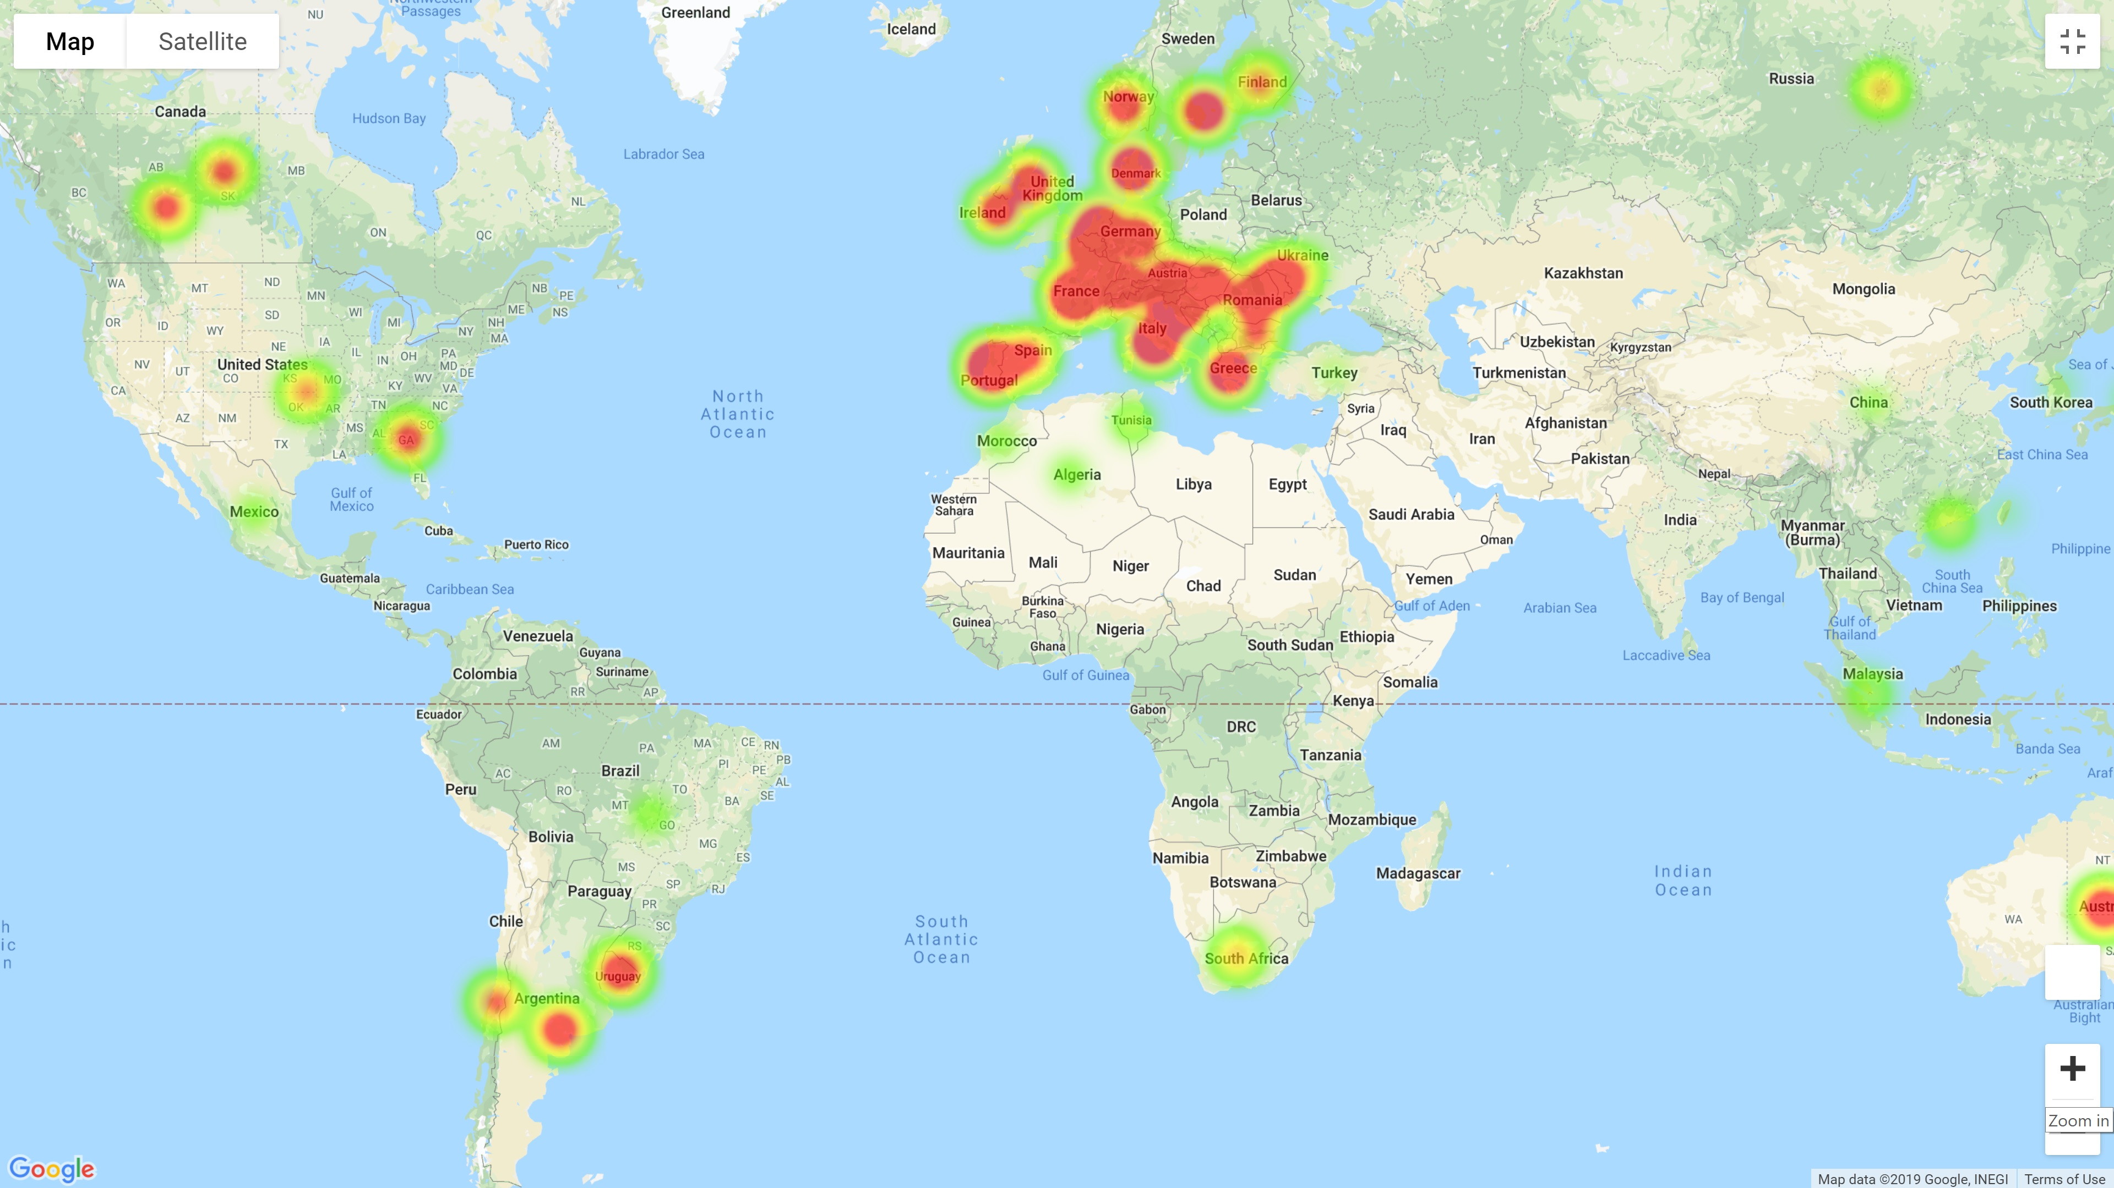
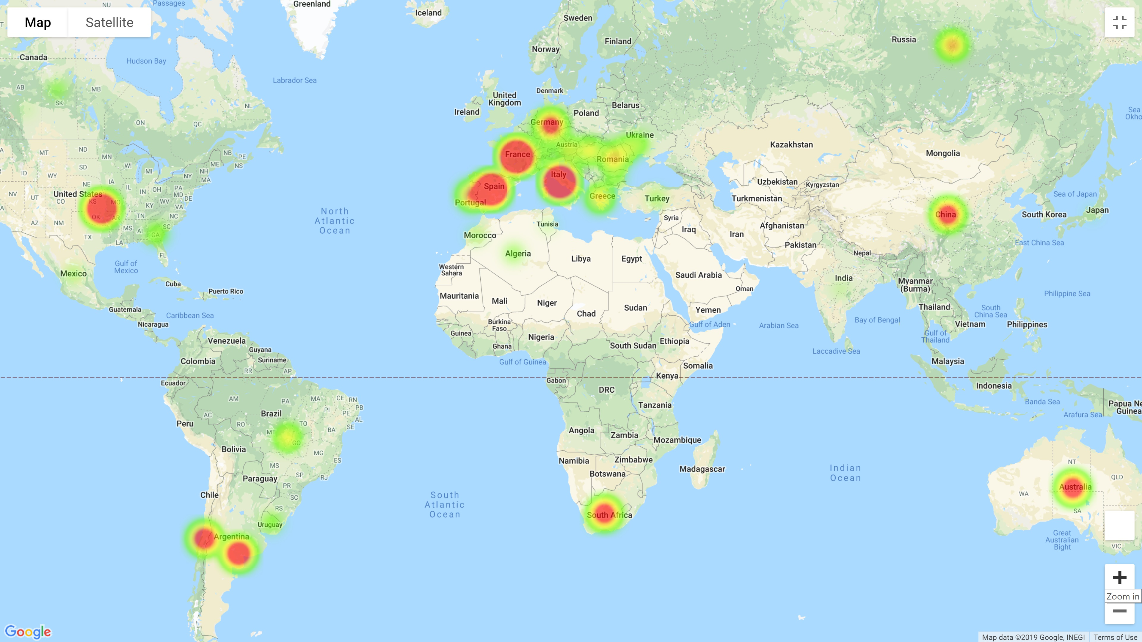
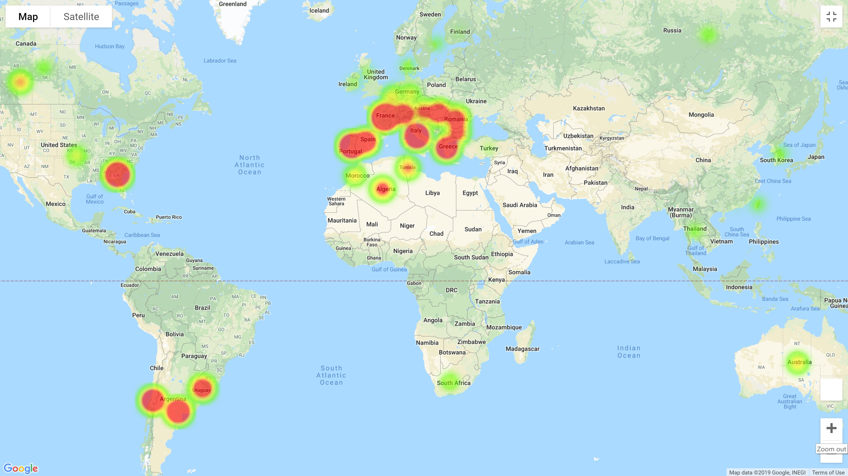
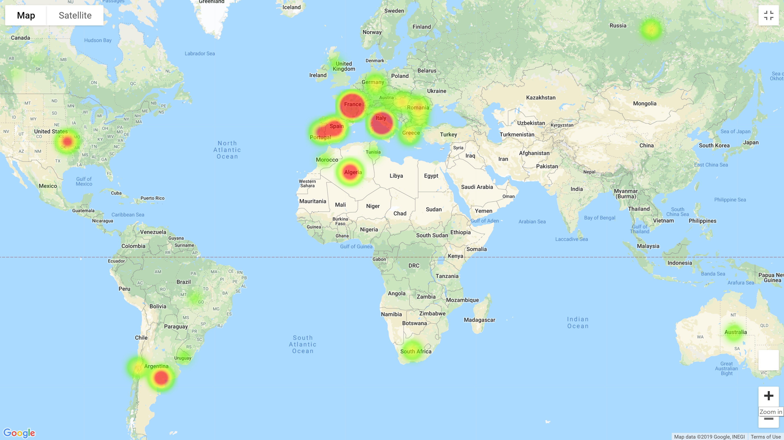
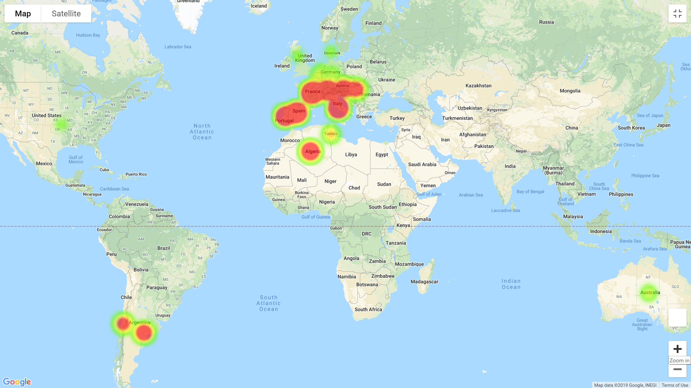
Wine Production
Wine Consumption
Wine Consumption per Capita
1900
1950
2014
Notes:
As Renato pointed out, by early 70s, the international trade of wine was very limited.
As the global trade expanded together with several national awareness both in European countries and emerging wine markets such as U.S., England, China, and Australia, the production and consumption trends dramatically changed.
As we notice in the top figure, the primary wine production countries in the beginning of the 20th century were only France, Italy, and Spain. Since the end of the 2nd World war till now, however, several other players added to the wine game. As we notice here, countries like U.S., Australia, Southern Americans, and to some extent the Eastern Asians.
The wine consumption pattern both in volumetric and per capita scales were also changed rapidly. While most of the wine produced in the western Europe, were consumed domestically in 1900, the global consumption include many other wine lovers.
Lesson 1: there are potential emerging markets for the wine investors. Some countries such as China outsource their wine requirements and many wine consumers in Africa require to pay the expensive imported wine primarily because low rating domestic wines.
Lesson 2: Climate change drastically impacts the wine production (e.g. drought in Chile and California or reported harsh weather in France and Italy that reduced the wine production in several periods). The infrastructure of next generation of wine yards must be more tolerant to the climate change yet by providing affordable wine to average-class consumers.

Slide 18
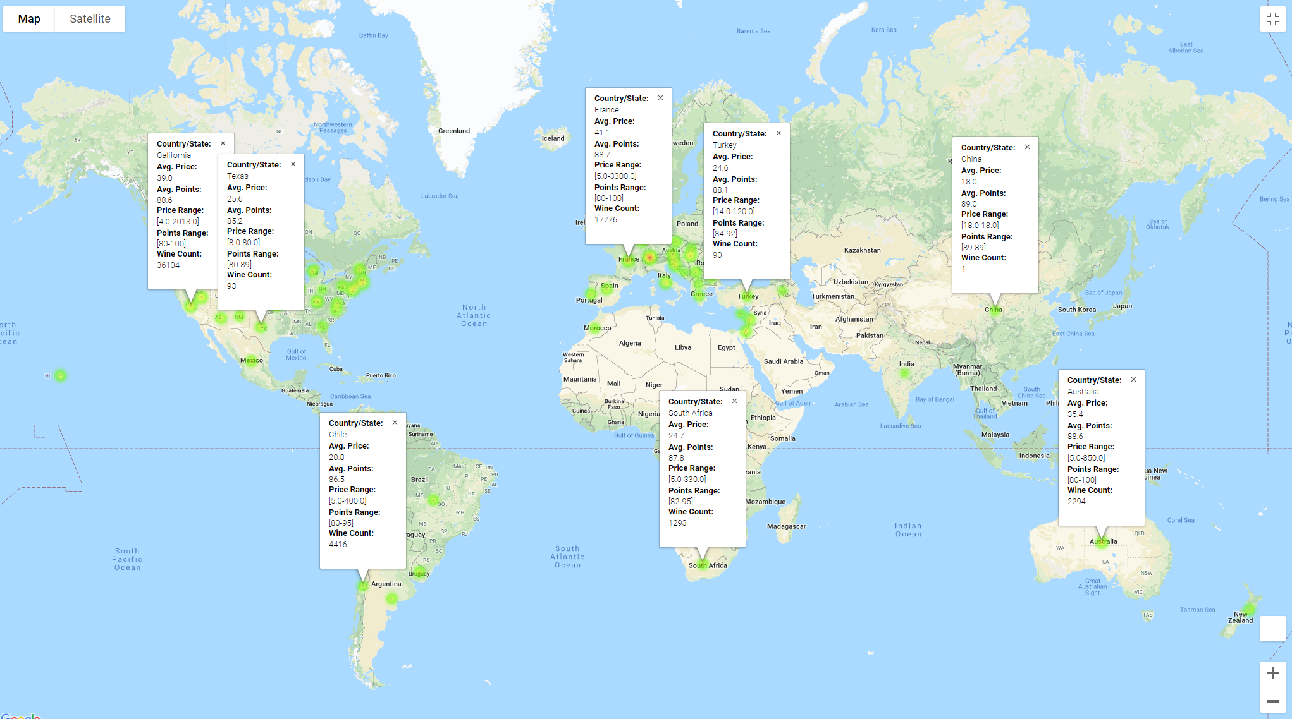

Slide 19
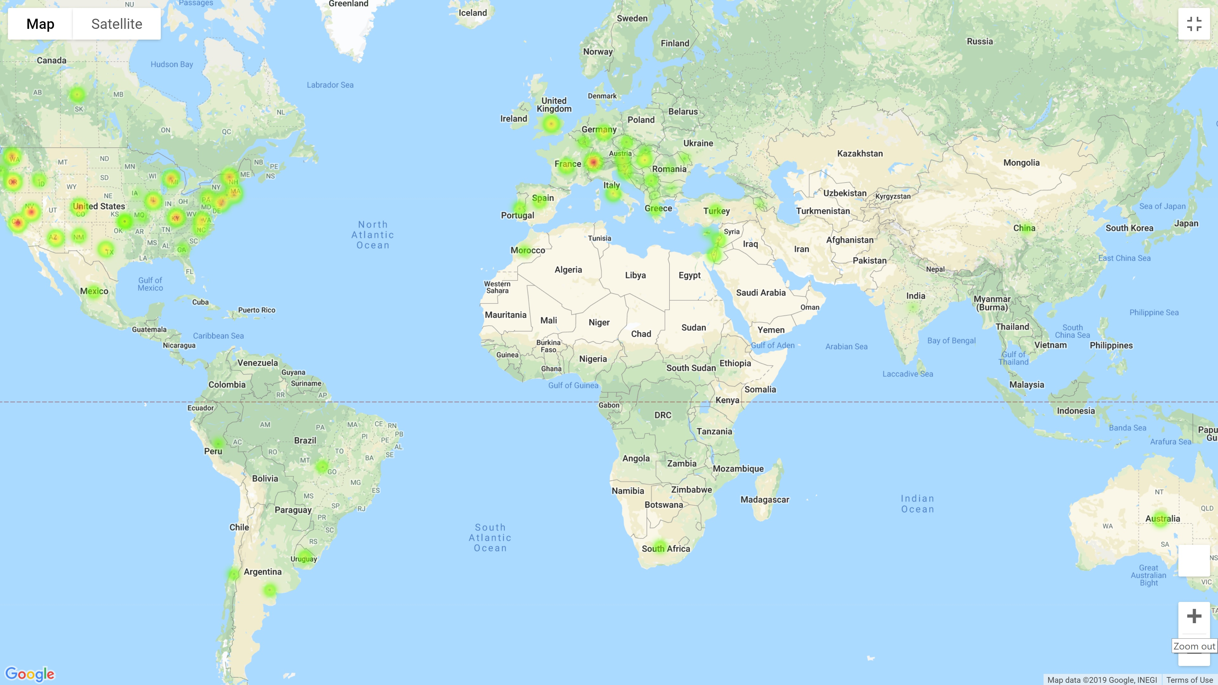
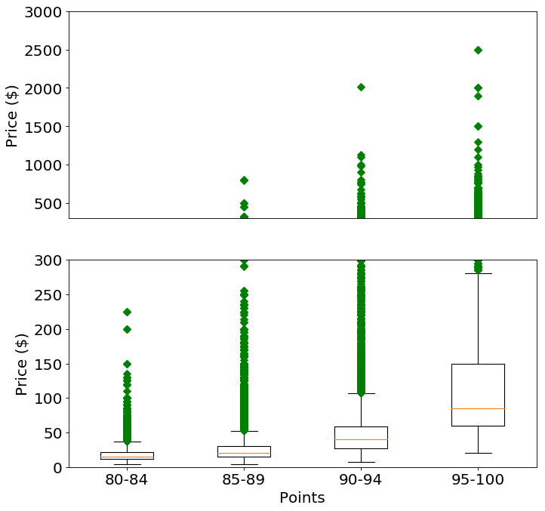
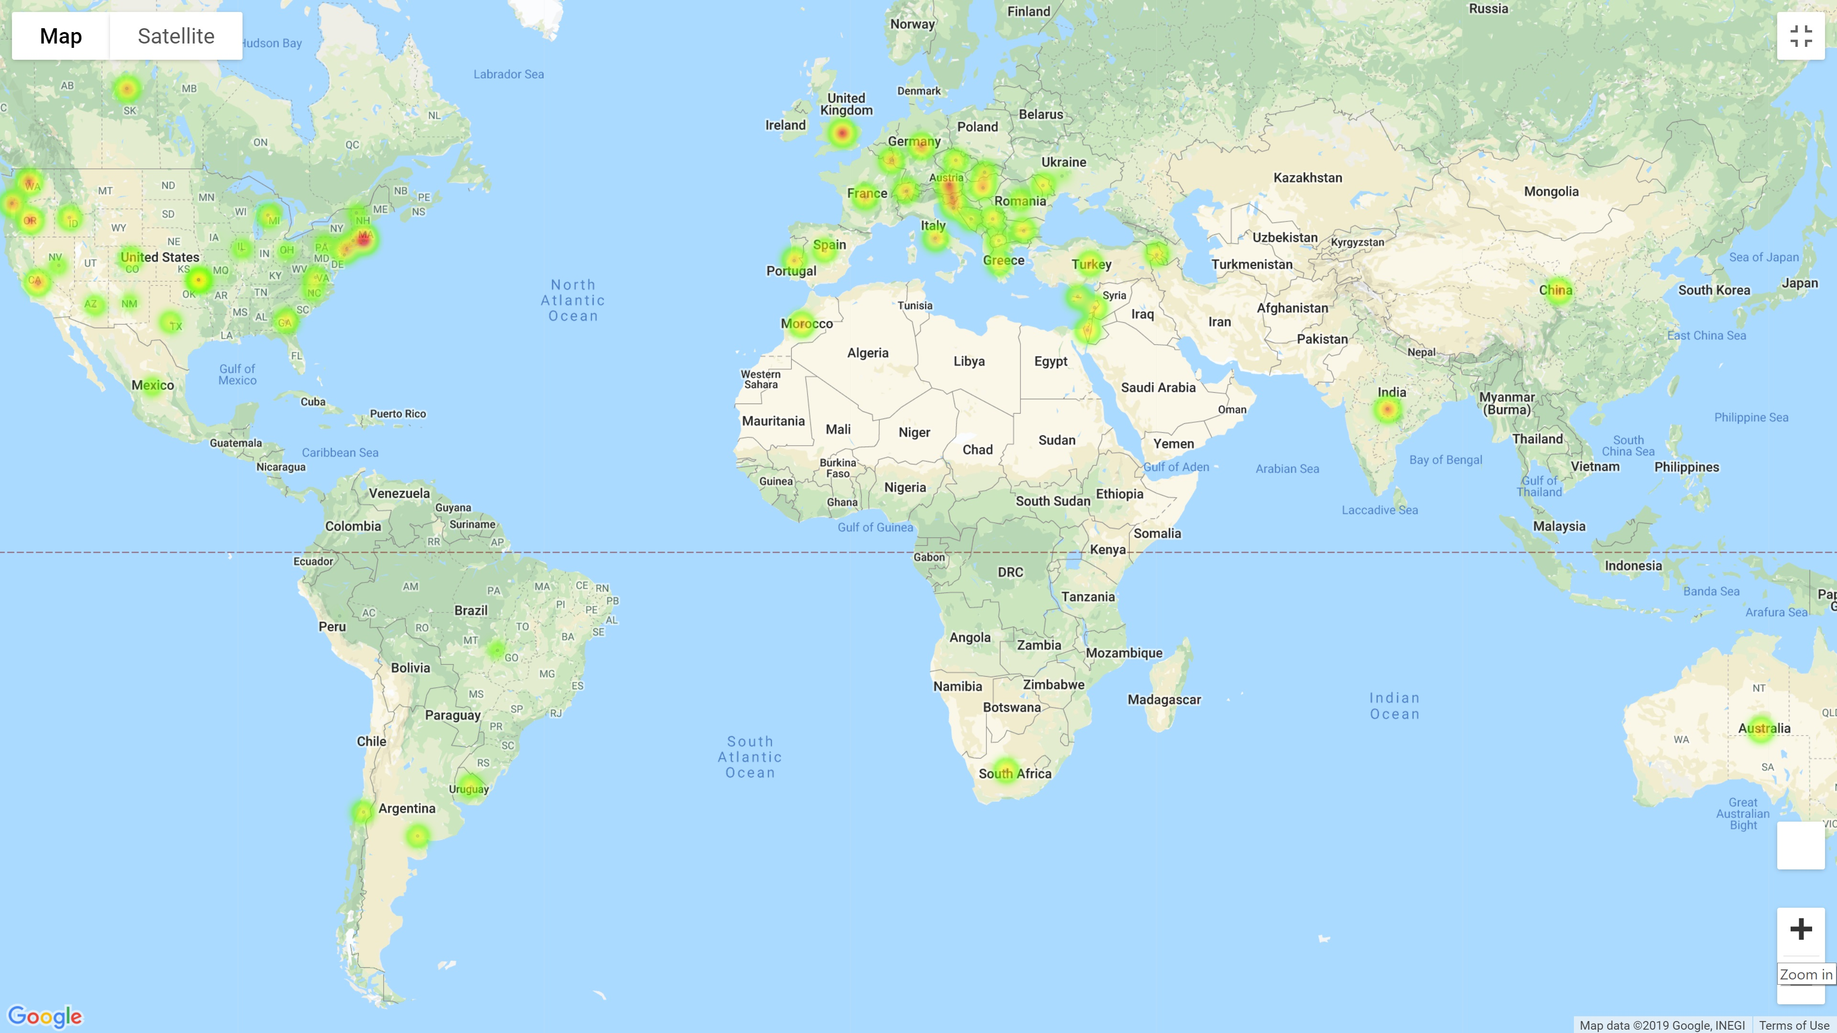
Price
Points
Notes:
Lesson1:
Lesson2:

Slide 20
QUESTIONS?

